Slide 1

What Is Agile Management?
Jurgen Appelo version 2

Slide 2
Let’s begin at the beginning...

Slide 3
1950
1960
1970
1980
1990
2000
2010
Computer Programming
Software Engineering
Agile Development

Slide 4
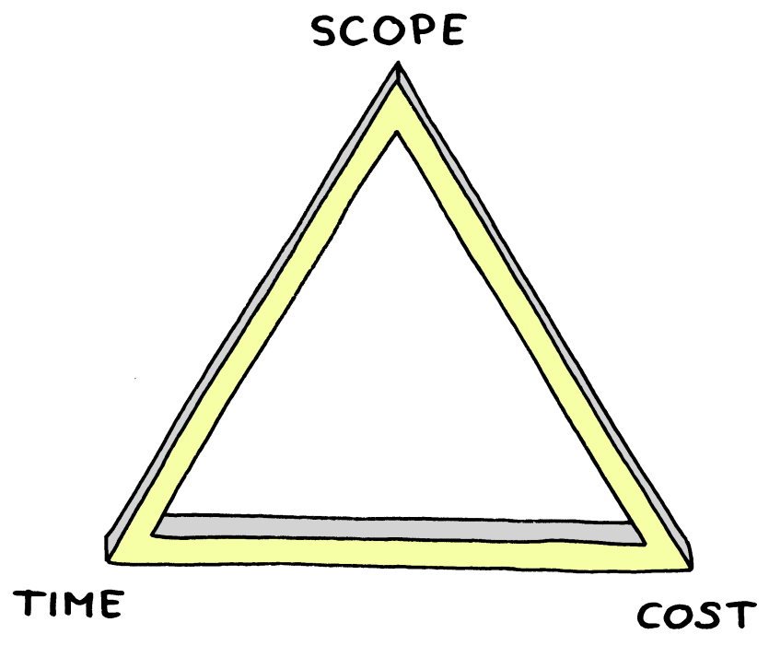
The traditional way of looking at projects

Slide 5
Some new insights from Agile gurus
Split Cost (Resources) in People and Tools
Split Scope in Functionality and Quality (suggestion: Scott Ambler)
Add a dimension for Process (suggestion: Alistair Cockburn)
Add a dimension for (Business) Value (suggestion: Jim Highsmith)
http://www.ambysoft.com/essays/brokenTriangle.html
http://alistair.cockburn.us/index.php/Process:_the_fourth_dimension
http://blog.cutter.com/2009/08/10/beyond-scope-schedule-and-cost-measuring-agile-performance/

Slide 6
And we get...
the 7 dimensions of software projects
1. Value
2. People
3. Functionality
4. Quality
5. Tools
6. Time
7. Process

Slide 7
So, what does it mean to be Agile?

Slide 8
Value
embracing change
increments
prioritization
value mapping
feedback
frequent delivery
value streams

Slide 9
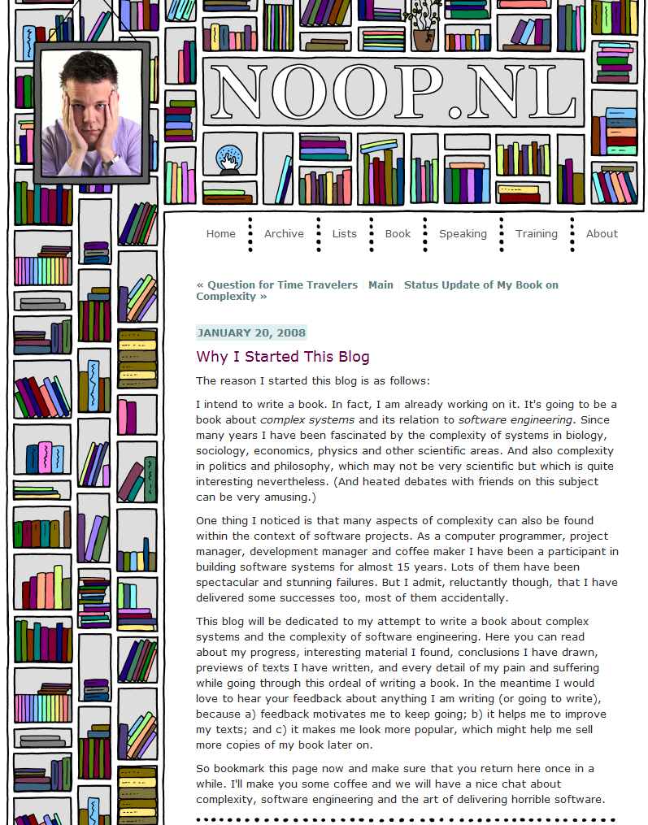
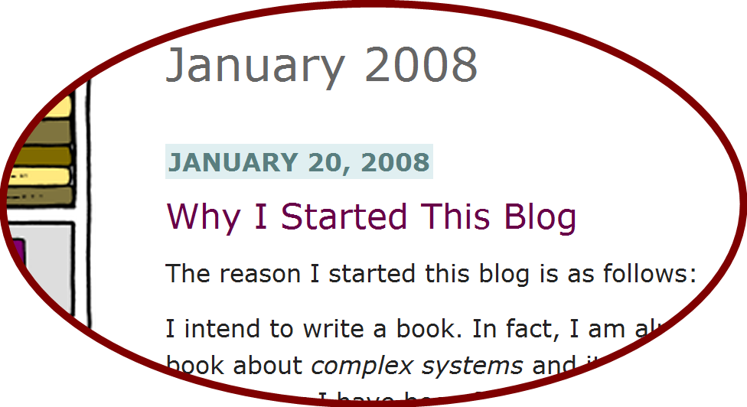
Example:
writing a blog to find value through feedback

Slide 10
People
cross-functional
colocation
interaction
respect
small teams
collaboration
accountability
trust
self-organization

Slide 11






Example:
using social networks to nurture interaction

Slide 12
Functionality
minimal marketable features
customer involvement
user stories
backlogs
user demos
acceptance criteria
“inch-deep, mile-wide”

Slide 13
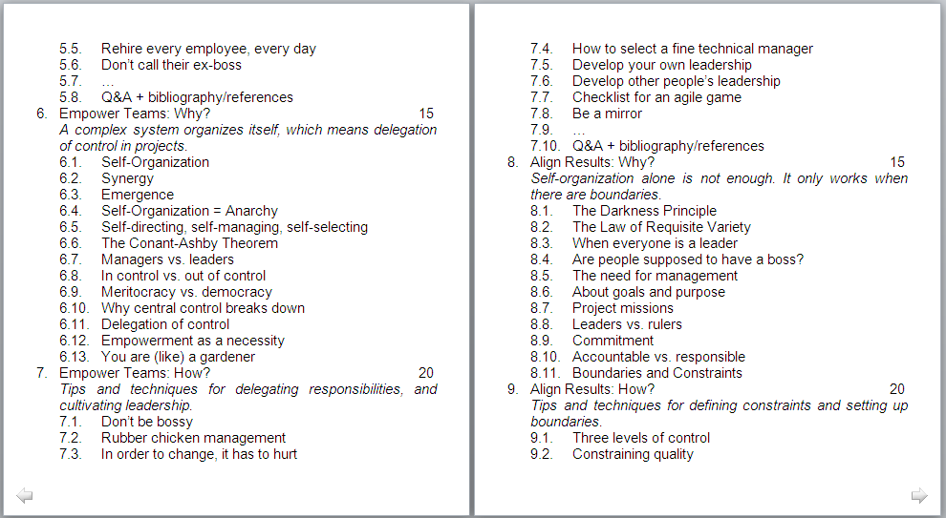
Example:
writing a book proposal as a backlog of topics

Slide 14
Quality
test-driven development
technical excellence
definition of done
refactoring
emergent design
pair programming
simplicity

Slide 15
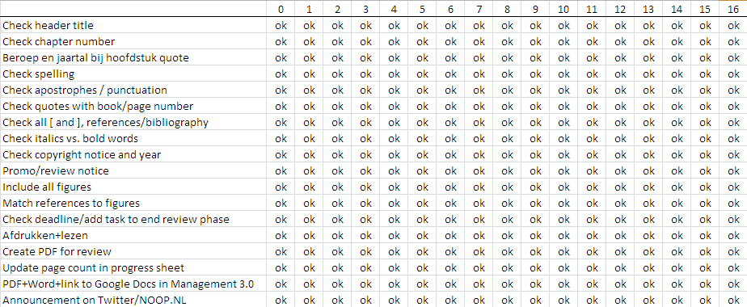
Example:
using checklists as a Definition of Done

Slide 16
Tools
open offices
task boards
daily builds
version control
continuous integration
automated testing
burn charts

Slide 17
Example:
Using simple tools that fit the worker

Slide 18
Time
rolling wave planning
timeboxes
potentially shippable products
release planning
iterations
sprints
sustainable pace

Slide 19
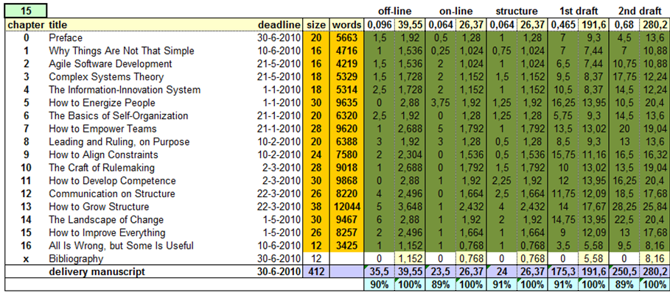
Example:
writing in a timebox to a deadline

Slide 20
Process
sprint planning
stand-up meetings
collective code ownership
velocity
retrospectives
planning poker
spikes

Slide 21
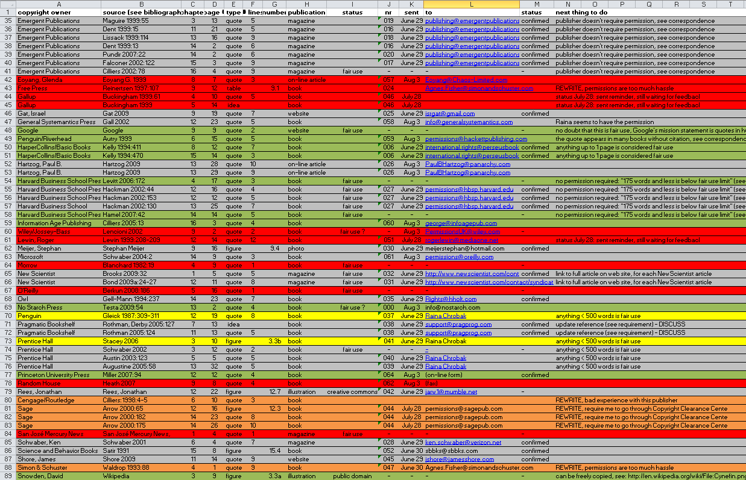
Example:
Figuring out a permission requests process

Slide 22
Result:
A product created in a (more or less) Agile way

Slide 23
So, how is the rest of the world handling Agile?

Slide 24
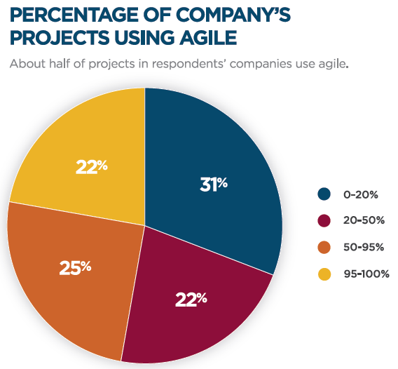

http://www.versionone.com/state_of_agile_development_survey/10/

Slide 25
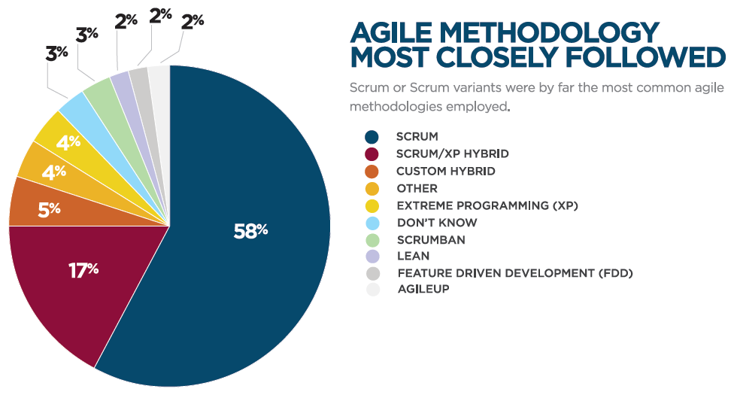
http://www.versionone.com/state_of_agile_development_survey/10/

Slide 26
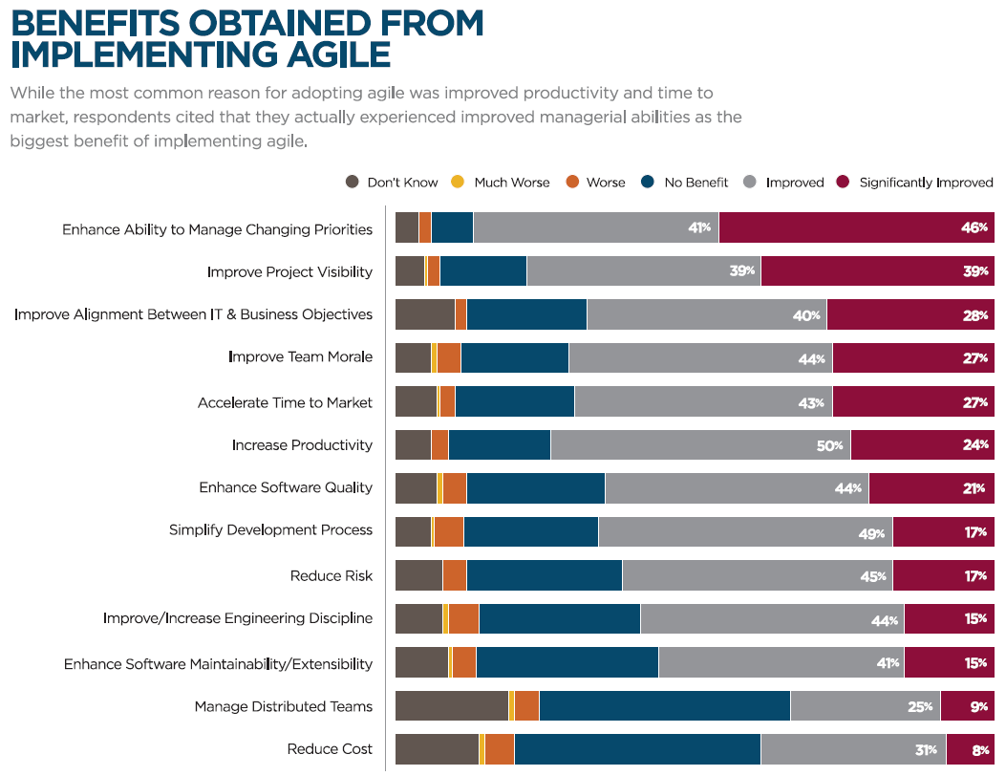
http://www.versionone.com/state_of_agile_development_survey/10/

Slide 27
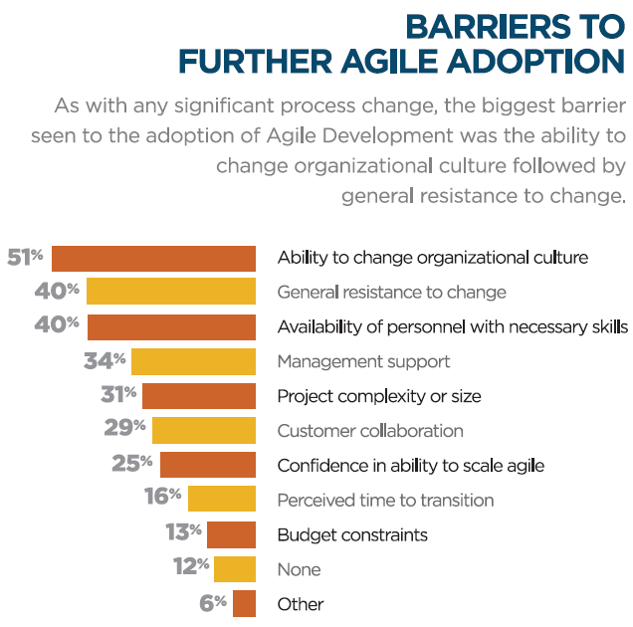
http://www.versionone.com/state_of_agile_development_survey/10/

Slide 28
So, what should managers do to be Agile?

Slide 29
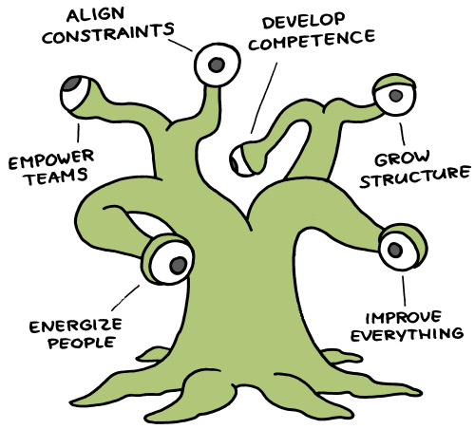
The Management 3.0 Model

Slide 30

View #1: Energize People
People are the most important parts of an organization and managers must do all they can to keep people active, creative, and motivated.

Slide 31
Manage the Information-Innovation system

Slide 32
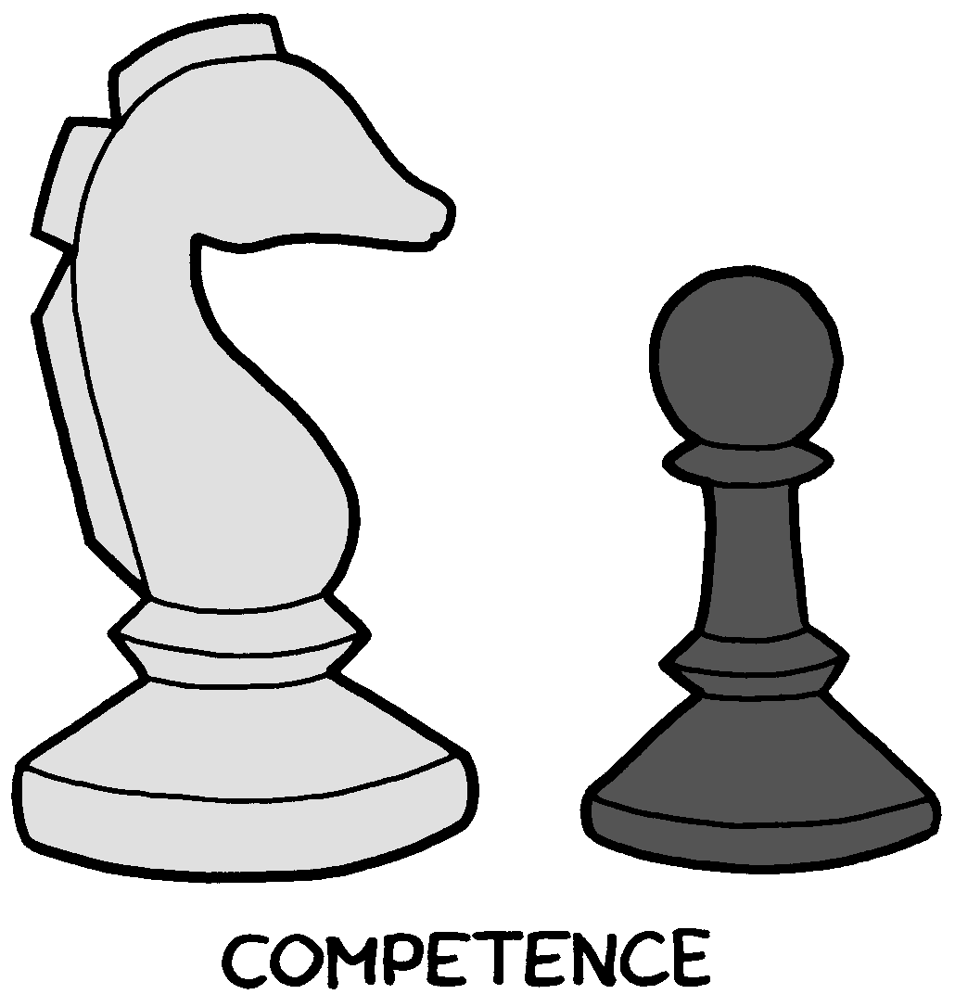


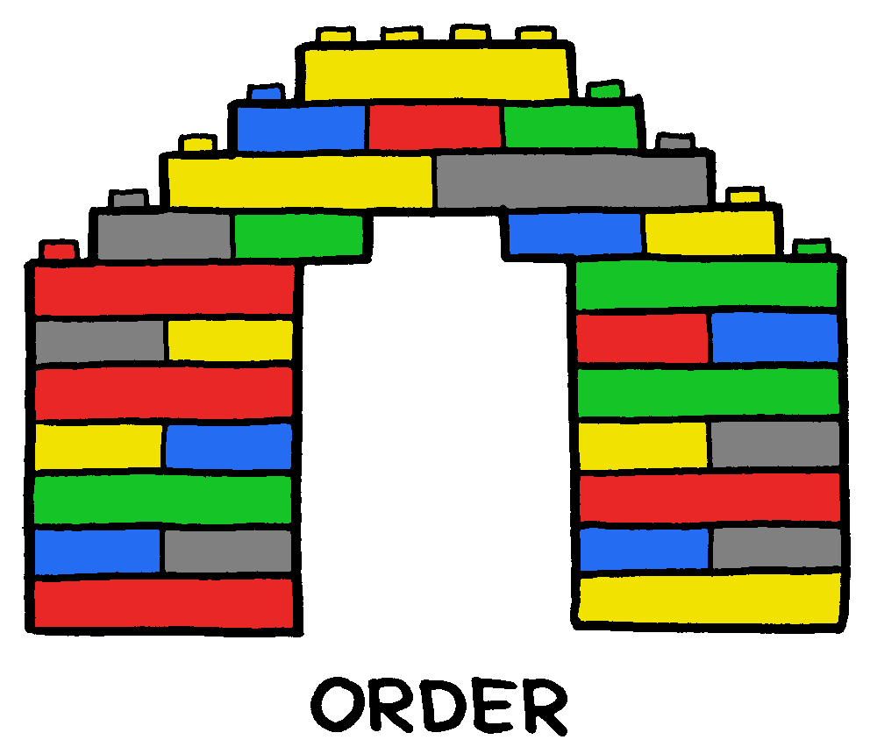




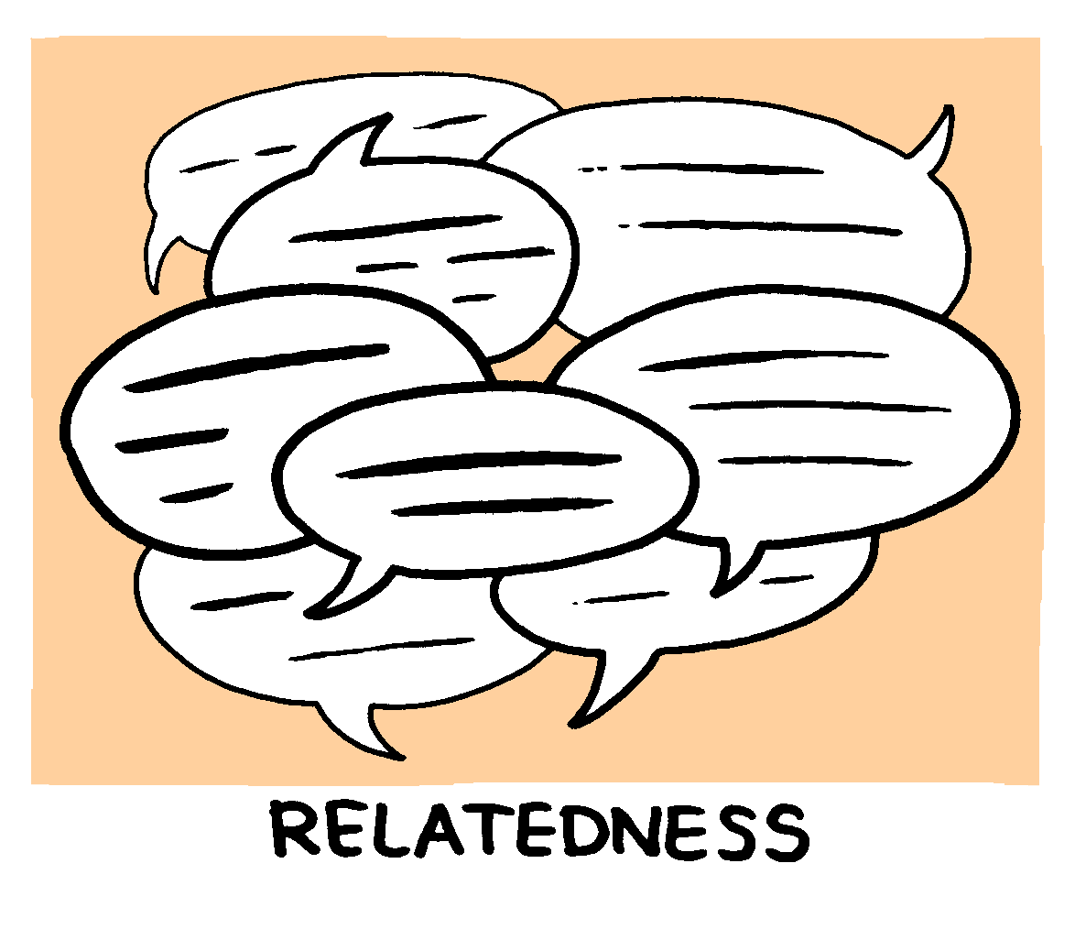
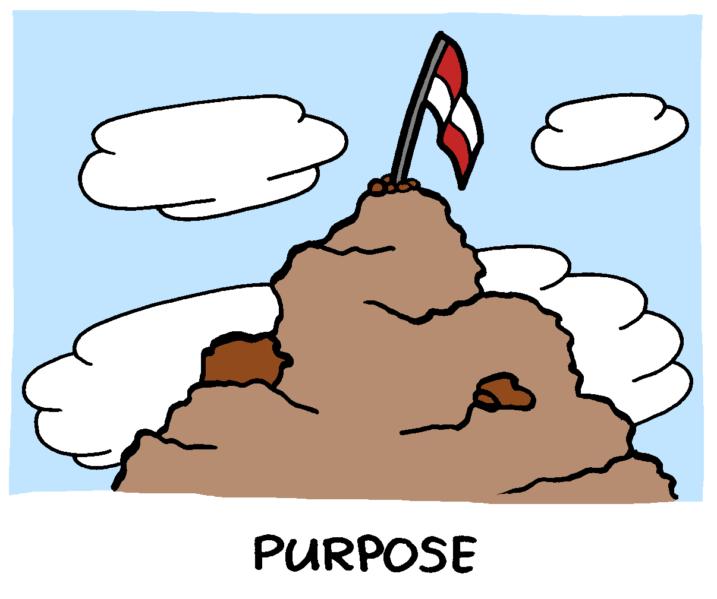
Understand people’s intrinsic desires

Slide 33
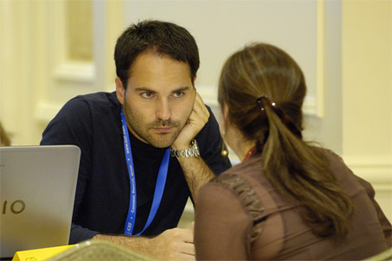
Organize one-on-one meetings

Slide 34
Ask Gallup’s 12 questions
Do I know what is expected of me at work?
Do I have the materials and equipment I need to do my work right?
At work, do I have the opportunity to do what I do best every day?
In the last seven days, have I received recognition or praise for doing good work?
Does my supervisor, or someone at work, seem to care about me as a person?
Is there someone at work who encourages my development?
At work, do my opinions seem to count?
Does the mission/purpose of my company make me feel my job is important?
Are my co-workers committed to doing quality work?
Do I have a best friend at work?
In the last six months, has someone at work talked to me about my progress?
This last year, have I had opportunities at work to learn and grow?

Slide 35
Organize 360 degree evaluations meetings

Slide 36
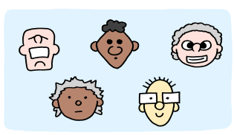
View #2: Empower Teams
Teams can self-organize, and this requires empowerment, authorization, and trust from management.

Slide 37
Manage like a gardener

Slide 38

Define key decision areas
People should not walk into “invisible electric fences”

Slide 39

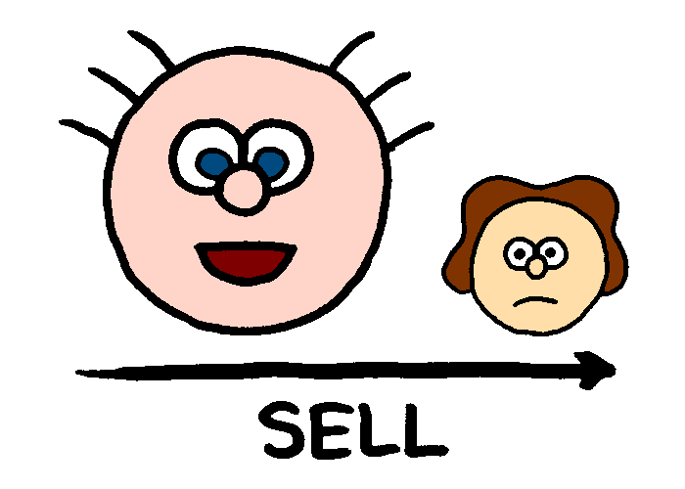
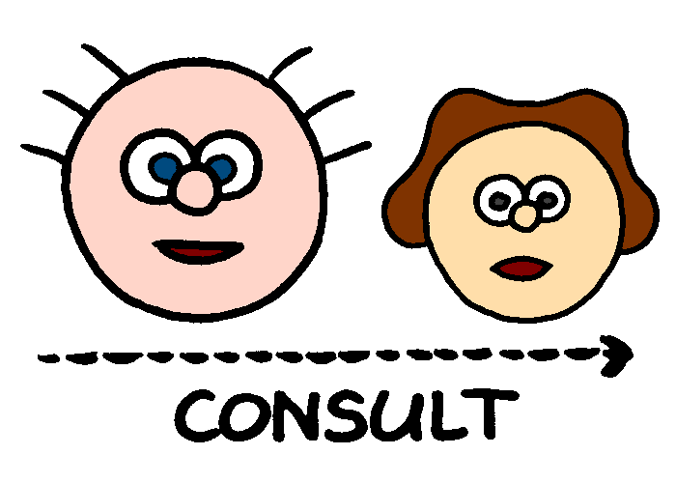
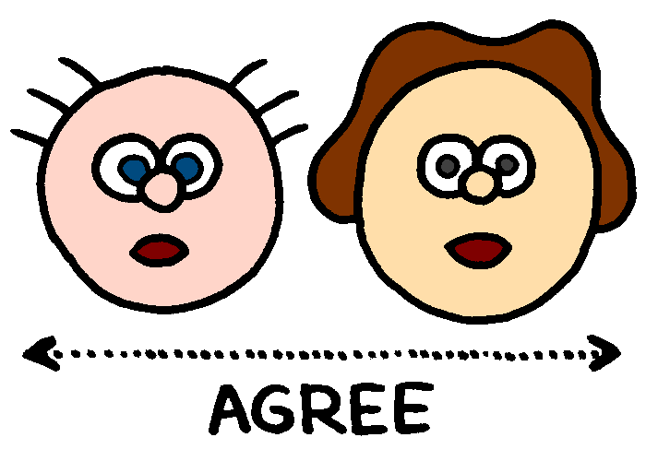
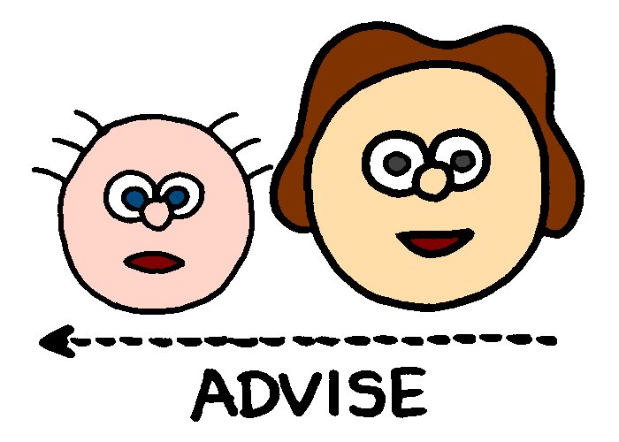
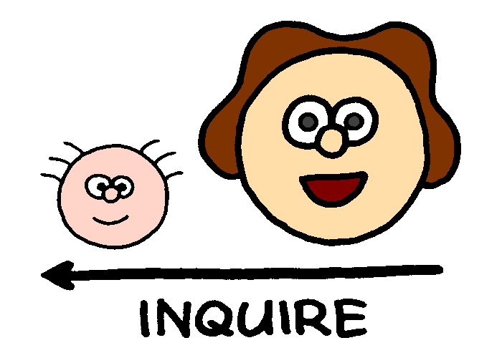

Use the Seven Levels of Authority
Tell: make decision as the manager
Sell: convince people about decision
Consult: get input from team before decision
Join: make decision together with team
Advise: influence decision made by the team
Confirm: ask feedback after decision by team
Delegate: no influence, let team work it out

Slide 40
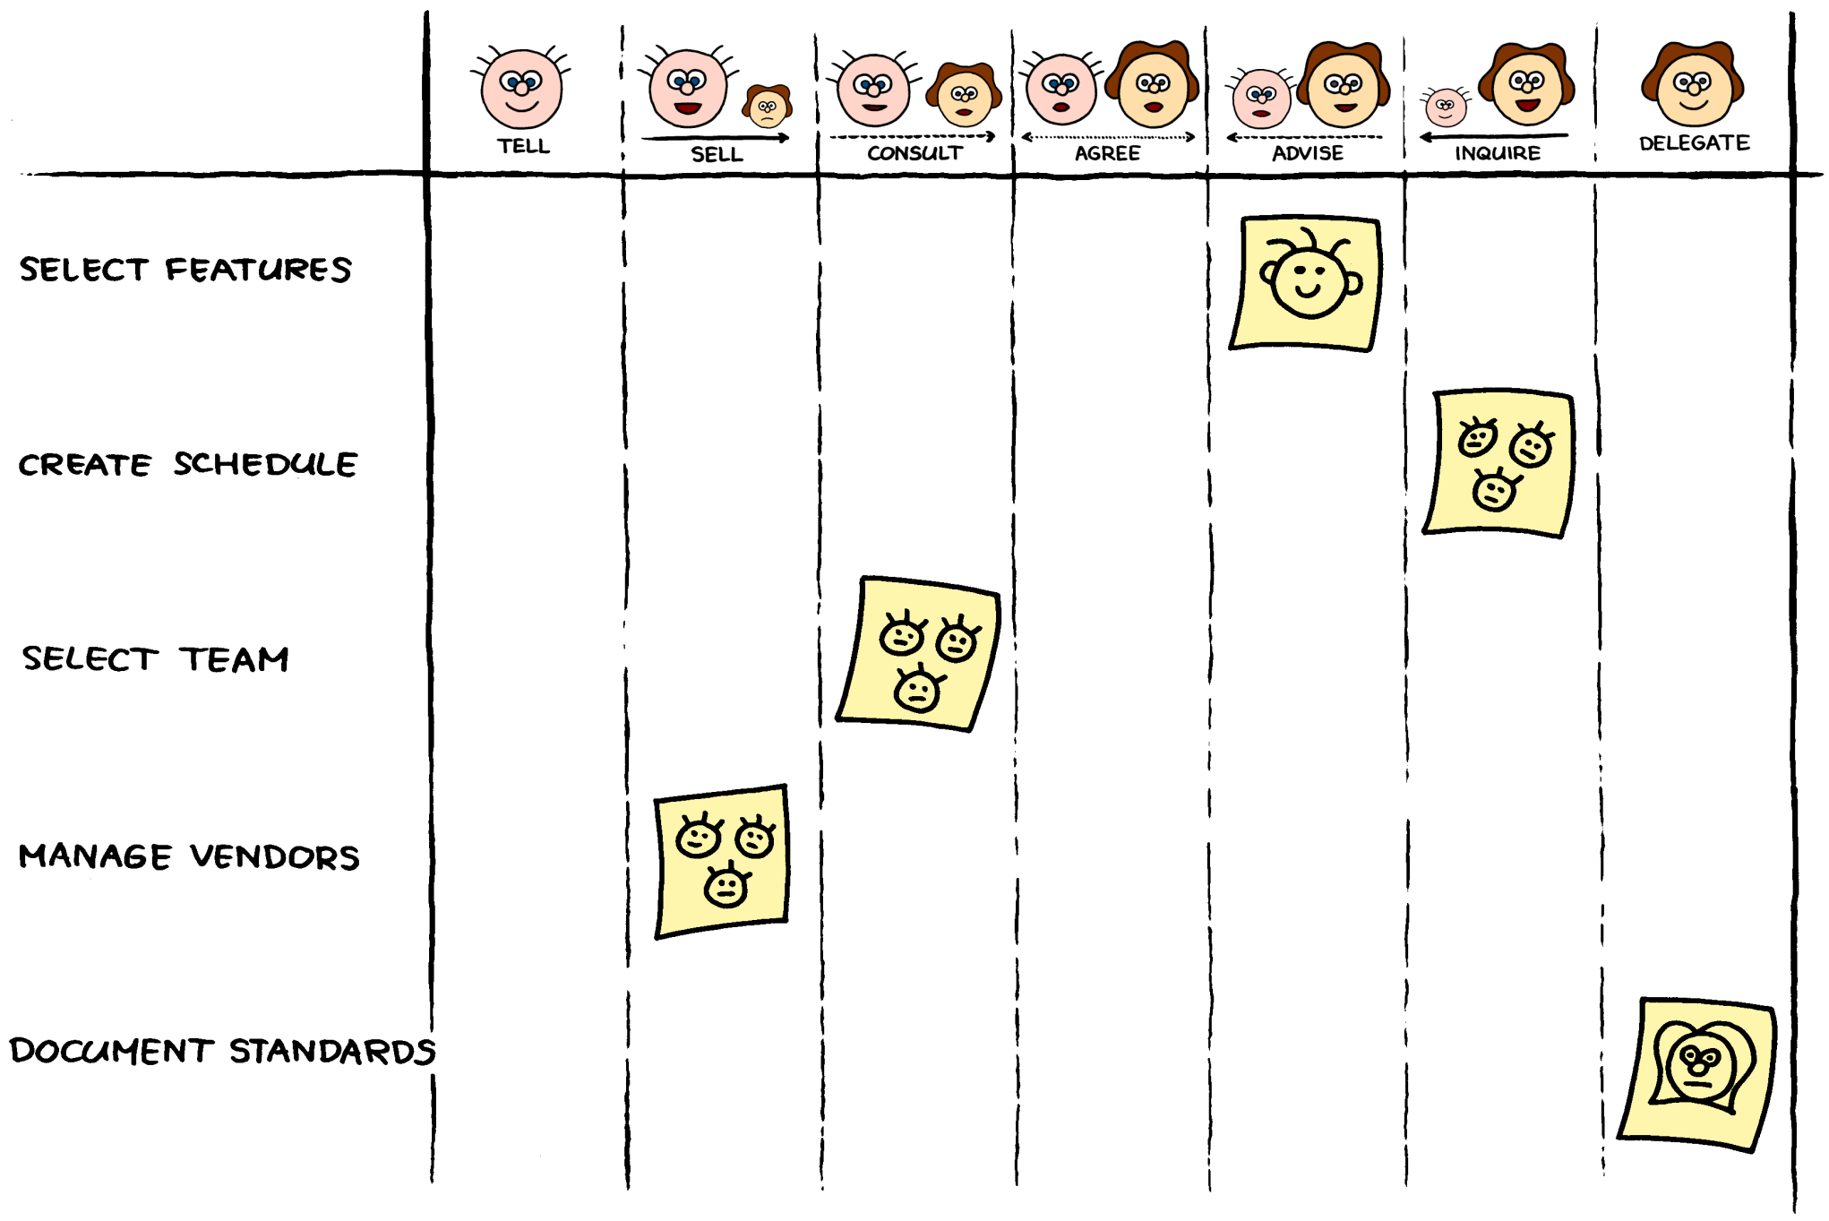
Create an authority board

Slide 41

View #3: Align Constraints
Self-organization can lead to anything, and it’s therefore necessary to protect people and shared resources, and to give people a clear purpose and defined goals.

Slide 42
Address the Tragedy of the Commons
Institutions create trust to accept common rules
Information increase understanding of situation
Identity increase social belonging across teams
Incentives address the need to improve oneself
http://www.newscientist.com/article/mg20327225.700-triumph-of-the-commons-helping-the-world-to-share.html

Slide 43
Manage emergent and higher goals

Slide 44
Do not use targets and financial/extrinsic motivation

Slide 45

View #4: Develop Competence
Teams cannot achieve their goals if team members aren’t capable enough, and managers must therefore contribute to the development of competence.

Slide 46
Distinguish skill from discipline

Slide 47

Use 7 approaches to competency
1. Self-Development
2. Coaching & Mentoring
3. Training & Certification
4. Culture & Socialization
5. Tools & Infrastructure
6. Supervision & Control
7. Management

Slide 48
Individuals
Teams
Departments
Business Units
Organization
Prevent sub-optimization through metrics
1. Time
2. People
3. Tools
4. Functionality
5. Quality
6. Process
7. Value

Slide 49

View #5: Grow Structure
Many teams operate within the context of a complex organization, and thus it is important to consider structures that enhance communication .

Slide 50
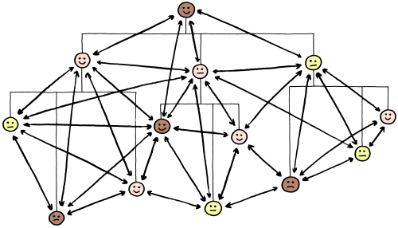
Manage the workplace as a network

Slide 51
Make people’s jobs dynamic

Slide 52
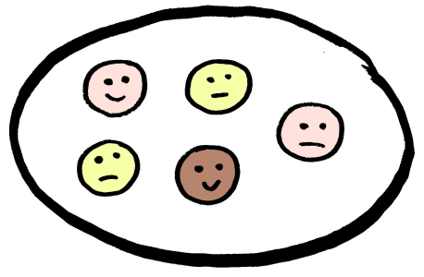
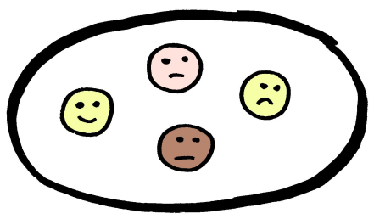

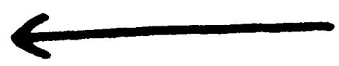
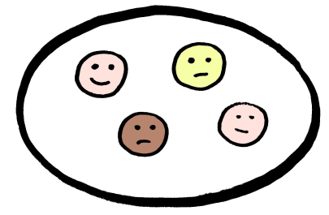
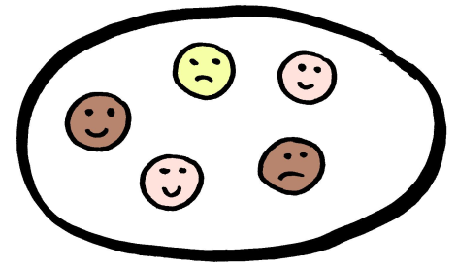
Design business with value units

Slide 53
View #6: Improve Everything
People, teams, and organizations need to improve continuously to defer failure for as long as possible.

Slide 54
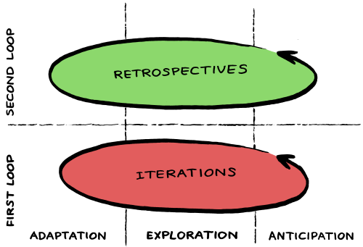
Apply 3 three drivers of improvement

Slide 55
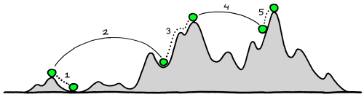
Apply nonlinear improvement
1, 3, 5
Kaizen
Gradual improvement
2, 4
Kaikaku
Radical improvement

Slide 56
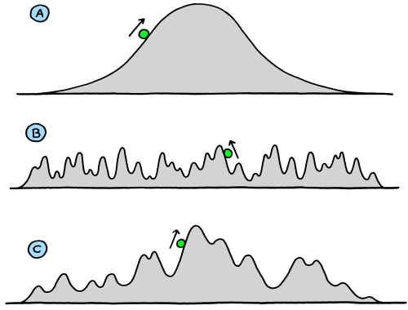
Prevent strong coupling of practices

Slide 57

The Management 3.0 Model

Slide 58
OK, maybe that was all a bit too much...
Just remember these 2 key takeways...

Slide 59
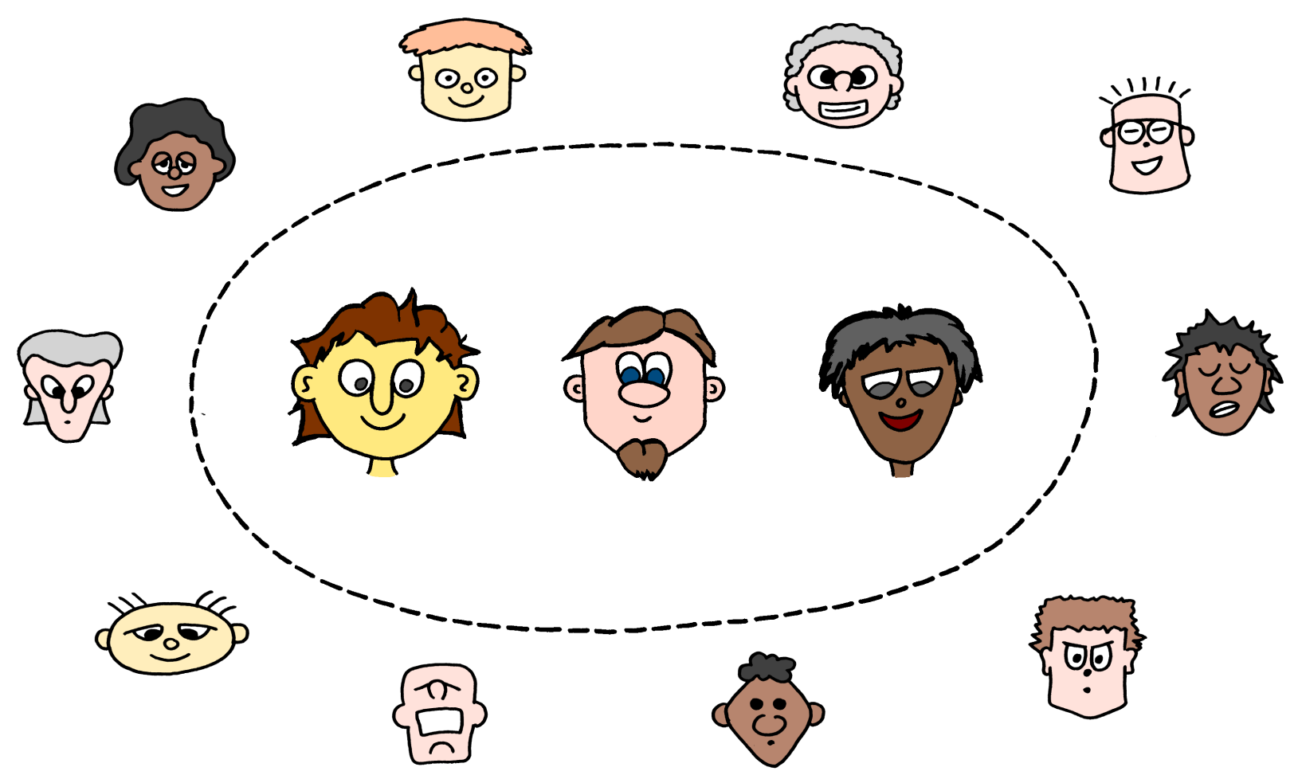
A software team is a self-organizing system
Support it, don’t obstruct it

Slide 60
Agile managers work the system around the team, not the people in the team

Slide 61


slideshare.net/jurgenappelo
@jurgenappelo (twitter)
noop.nl (blog)
jurgenappelo.com (site)
management30.com (book)

Slide 62
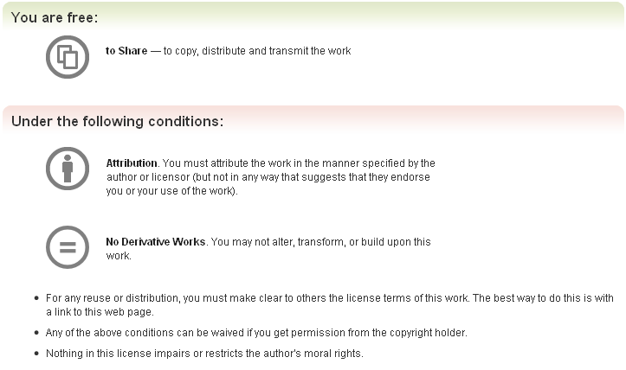
This presentation was inspired by the works of many people, and I cannot possibly list them all. Though I did my very best to attribute all authors of texts and images, and to recognize any copyrights, if you think that anything in this presentation should be changed, added or removed, please contact me at jurgen@noop.nl.
http://creativecommons.org/licenses/by-nd/3.0/

